Slide 1
Lab Session –II(b) Regularization in Linear Regression (Ridge and LASSO)
Dr. Jasmeet singh
Assistant Professor, CSED
TIET, Patiala

Slide 2
Regularization
Regularization is a technique used for tuning the function by adding an additional penalty term in the error function that reduces the magnitude of parameters .
In regression models, we do not know which regression coefficients we should shrink by adding their penalty in the cost function.
So, the general tendency of applying regularization in regression is to shrink the weight (regression coefficients) of all the input variables.
Two most commonly used regularization in linear regression are:
Ridge Regression (L2 Normalization)
Least Absolute Selection and Shrinkage Operator (LASSO) Regression (L! Normalization)

Slide 3
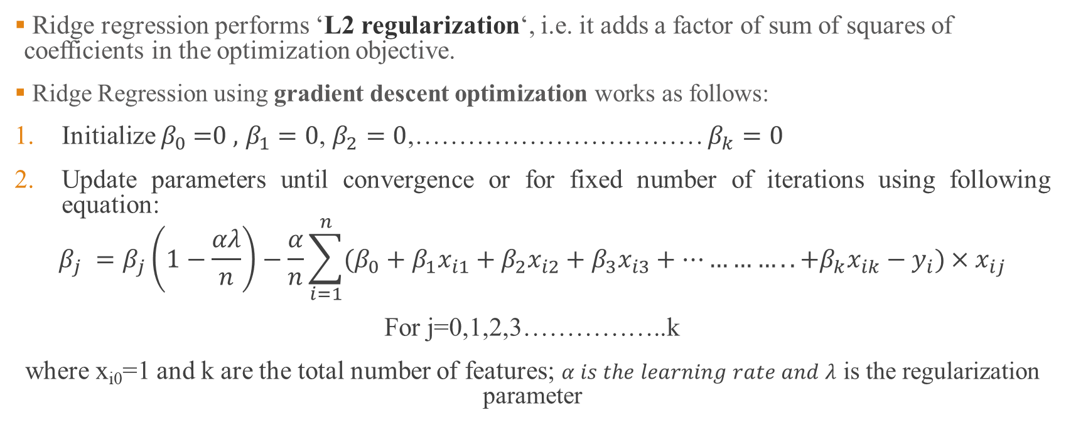
Ridge Regression
Ridge regression performs ‘L2 regularization‘, i.e. it adds a factor of sum of squares of coefficients in the optimization objective.
Ridge Regression using gradient descent optimization works as follows:
Initialize $β_{0}\text{ =0 }\text{,} β_{1}=0$, $β_{2}=0$,…………………………… $β_{k}=0$
Update parameters until convergence or for fixed number of iterations using following equation:
$$β_{j} =β_{j}\left(1−\frac{αλ}{n}\right)−\frac{α}{n}\sum_{i=1}^{n}{(β_{0}+β_{1}x_{i1}+β_{2}x_{i2}+β_{3}x_{i3}+…………..{+β}_{k}x_{ik}−y_{i})}×x_{ij}$$
For j=0,1,2,3……………..k
where x_{i0}=1 and k are the total number of features; $α is the learning rate and λ$ is the regularization parameter

Slide 4
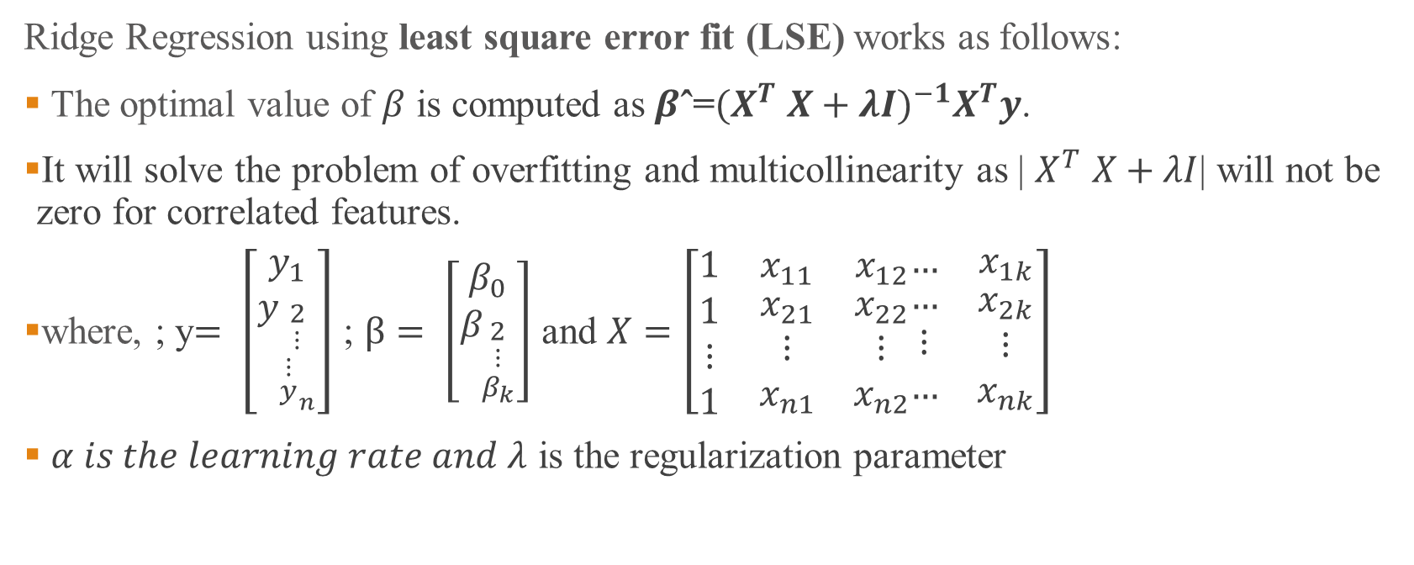
Ridge Regression- Contd….
Ridge Regression using least square error fit (LSE) works as follows:
The optimal value of $β$ is computed as $β\text{ˆ=}{{(X}^{T} X+λI)}^{−1}X^{T}y$.
It will solve the problem of overfitting and multicollinearity as | $X^{T} X+λI$| will not be zero for correlated features.
where, ; y$= \left[\begin{matrix}y_{1} \\ y_{\begin{aligned}2 \\ ⋮ \\ {\begin{aligned}⋮ \\ y\end{aligned}}_{n}\end{aligned}}\end{matrix}\right]$ ; $β= \left[\begin{matrix}β_{0} \\ β_{\begin{aligned}2 \\ ⋮ \\ β_{k}\end{aligned}}\end{matrix}\right]$ and $X=\left[\begin{matrix}1 & x_{11} & x_{12} \\ \begin{aligned}1 \\ ⋮ \\ 1\end{aligned} & \begin{aligned}x_{21} \\ ⋮ \\ x_{n1}\end{aligned} & \begin{aligned}x_{22} \\ ⋮ \\ x_{n2}\end{aligned}\end{matrix}\begin{matrix}… & x_{1k} \\ \begin{aligned}… \\ ⋮ \\ …\end{aligned} & \begin{aligned}x_{2k} \\ ⋮ \\ x_{nk}\end{aligned}\end{matrix}\right]$
$α is the learning rate and λ$ is the regularization parameter

Slide 5
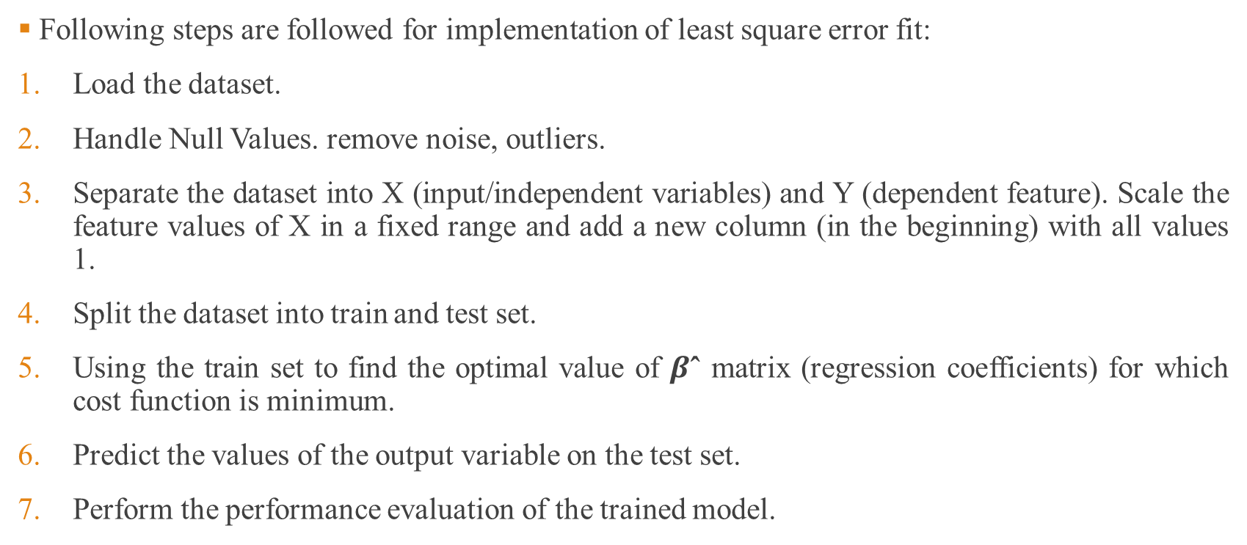
Implementation Ridge Regression (LSE Fit) (Step-by-Step)
Following steps are followed for implementation of least square error fit:
Load the dataset.
Handle Null Values. remove noise, outliers.
Separate the dataset into X (input/independent variables) and Y (dependent feature). Scale the feature values of X in a fixed range and add a new column (in the beginning) with all values 1.
Split the dataset into train and test set.
Using the train set to find the optimal value of $β\text{ˆ}$ matrix (regression coefficients) for which cost function is minimum.
Predict the values of the output variable on the test set.
Perform the performance evaluation of the trained model.

Slide 6
Step 1 (Ridge-LSE): Load the Dataset
For implementation of Ridge Regressio using least square error fit we will generate a dataset with highly correlated values.
We have simulated a sine curve (between 60° and 300°) and added some random noise.
Let’s try to estimate the sine function using polynomial regression with powers of x from 1 to 15.
Let’s add a column for each power upto 15 in our dataframe.
Since the data is generated by ourself, so there is no missing value . Noise is handled by regularization only. So, step two is not required.
Code:
x = np.array([i*np.pi/180 for i in range(60,300,4)])
np.random.seed(10) #Setting seed for reproducibility
y = np.sin(x) + np.random.normal(0,0.15,len(x))
df= pd.DataFrame(np.column_stack([x,y]),columns=['x','y'])
for i in range(2,16): #power of 1 is already there
colname = 'x_%d'%i #new var will be x_power
df[colname] = df['x']**i
print(df)

Slide 7
Step 3 (Ridge-LSE): Split Input & Output Features
Separate the dataset into X (input/independent variables) and Y (dependent feature).
Scale the feature values of X in a fixed range.
Add a new column (in the beginning) with all values 1.
Code:
X=df.drop(['y'],axis=1)
Y=df.iloc[:,1]
from sklearn.preprocessing import StandardScaler
scaler=StandardScaler()
X_scaled=scaler.fit_transform(X)
X_scaled=np.insert(X_scaled,0,values=1,axis=1)

Slide 8
Step 4 (Ridge-LSE): Train/Test Split
We can split the train and test sets using train/test split of sklearn.model_selection as follows:
Code:
from sklearn.model_selection import train_test_split
X_train, X_test, Y_train, Y_test = train_test_split(X_scaled, Y, test_size=0.3, random_state=42)
Parameters:
test_size is the percentage of test set from the total dataset; random_state s used for initializing the internal random number generator, which will decide the splitting of data into train and test indices
If random_state is None or np.random, then a randomly-initialized RandomState object is returned.
If random_state is an integer, then it is used to seed a new RandomState object.

Slide 9
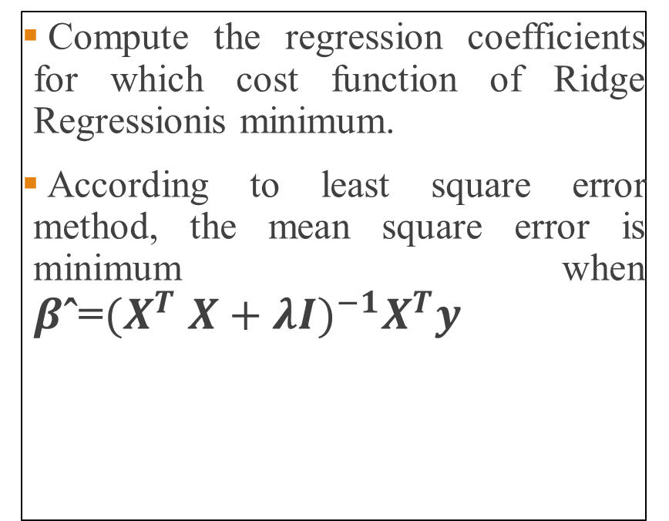
Step 5 (Ridge-LSE): Finding Regression Coefficients
Compute the regression coefficients for which cost function of Ridge Regressionis minimum.
According to least square error method, the mean square error is minimum when $β\text{ˆ}\text{=}{{(X}^{T} X+λI)}^{−1}X^{T}y$
Code:
lamba=0.001
A=X_train.T.dot(X_train)
B=A+lamba*I
C=np.linalg.inv(B)
D=C.dot(X_train.T)
beta=D.dot(Y_train)

Slide 10
Step 6 (Ridge-LSE) : Predicting values on test set
In this step, we predict the values of output variable on the test set.
It is done by multiplying X_test set with optimal Beta matrix as hown in the code below.
Code:
Y_predict=X_test.dot(beta)
print(Y_predict)

Slide 11
Step 7 (LSE): Performance Evaluation
We check the performance of the trained model by computing following error between the predicted and actual values:
Mean Square Error
Root Mean Square Error
R2_score
Code:
error=Y_test-Y_predict
square_error=np.power(error,2)
sum_square_error=np.sum(square_error)
mean_square_error=sum_square_error/len(y_predict)
print(mean_square_error)
rms_error=np.sqrt(mean_square_error)
print(rms_error)
y_mean=np.mean(Y_test)
total_variance=np.sum((Y_test-y_mean)**2)
print(1-sum_square_error/total_variance)

Slide 12
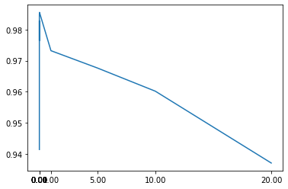

Finding value of Regularization Parameter ($λ$)
We can consider number of values of regularization parameter and then can check the value for which R2_score is maximum or cost of ridge regression is minimum.
lambda_ridge = [1e-15, 1e-10, 1e-8, 1e-4, 1e-3,1e-2, 1, 5, 10, 20]
from sklearn import metrics
R2_score=[]
for i in range(len(lambda_ridge)):
A=X_train.T.dot(X_train)
B=A+lambda_ridge[i]*I
C=np.linalg.inv(B)
D=C.dot(X_train.T)
beta=D.dot(Y_train)
Y_predict=X_test.dot(beta)
R2_score.append((metrics.r2_score(Y_test,Y_predict)))
import matplotlib.pyplot as plt
plt.plot(lambda_ridge,R2_score)

Slide 13
Inbuilt Ridge Function
Inbuilt Function:
sklearn.linear_model.Ridge(alpha=1.0, *, fit_intercept=True, normalize=False, copy_X=True, max_iter=None, tol=0.001, solver='auto', random_state=None)
Paramter
solver{‘auto’, ‘svd’, ‘‘lsqr’, ‘sparse_cg’, ‘sag’, ‘saga’}, default=’auto’
svd’ uses a Singular Value Decomposition
‘lsqr’ uses the dedicated regularized least-squares routine
‘sag’ uses a Stochastic Average Gradient descent, saga’ uses its improved, unbiased version
Example:
from sklearn.linear_model import Ridge
from sklearn import metrics
ridge=Ridge(alpha=0.001, normalize=True)
model=ridge.fit(X_train,Y_train)
Y_predict=model.predict(X_test)
print(metrics.r2_score(Y_test,Y_predict))

Slide 14
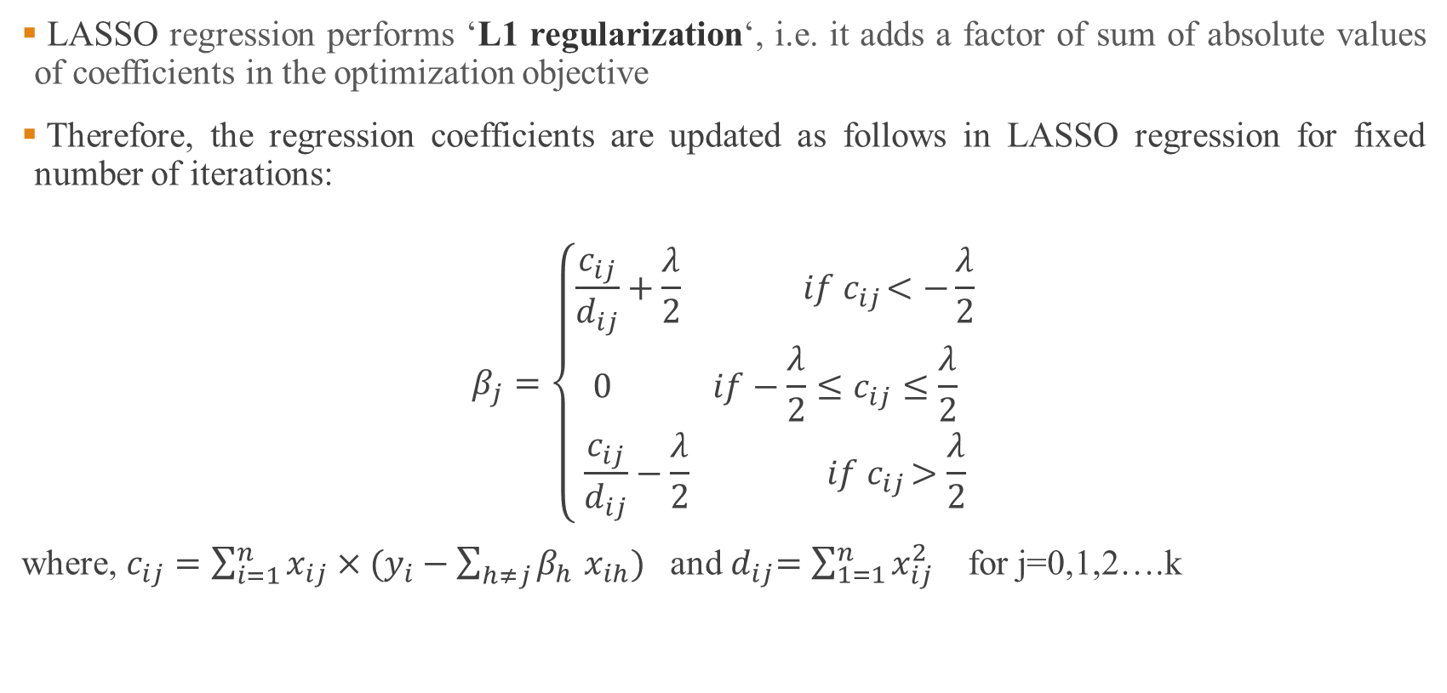
LASSO Regression
LASSO regression performs ‘L1 regularization‘, i.e. it adds a factor of sum of absolute values of coefficients in the optimization objective
Therefore, the regression coefficients are updated as follows in LASSO regression for fixed number of iterations:
$$β_{j}=\left\{\begin{aligned}\frac{c_{ij}}{d_{ij}}+\frac{λ}{2}{ if c}_{ij}<−\frac{λ}{2} \\ 0{ if−\frac{λ}{2}≤c}_{ij}≤\frac{λ}{2} \\ \frac{c_{ij}}{d_{ij}}−\frac{λ}{2}{ if c}_{ij}>\frac{λ}{2}\end{aligned}\right.$$
where, $c_{ij}=\sum_{i=1}^{n}{x_{ij}×(y_{i}−\sum_{h≠j}{β_{h}}}$ $x_{ih})$ and${ d}_{ij}=\sum_{1=1}^{n}{x_{ij}^{2}}$ for j=0,1,2….k

Slide 15
Inbuilt LASSO Function
Inbuilt Function:
sklearn.linear_model.Lasso(alpha=1.0, *, fit_intercept=True, normalize=False, precompute=False, copy_X=True, max_iter=1000, tol=0.0001, warm_start=False, positive=False, random_state=None, selection='cyclic')
Example:
from sklearn.linear_model import Lasso
from sklearn import metrics
lasso=Lasso(alpha=0.001, normalize=True)
model=lasso.fit(X_train,Y_train)
Y_predict=model.predict(X_test)
print(metrics.r2_score(Y_test,Y_predict))

